Slide 1
SysBio Journal Club 31st October 2024
Callum Marples

Slide 2
Today’s Paper
Interplay of curvature and rigidity in shape-based models of confluent tissues
Sussman, D. M. (2020). Interplay of curvature and rigidity in shape-based models of confluent tissue. Physical Review Research, 2(2), 023417.
DOI: 10.1103/PhysRevResearch.2.023417

Slide 3
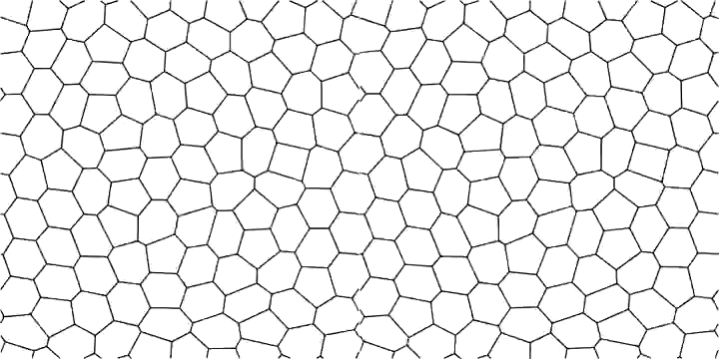
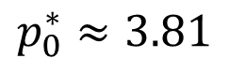
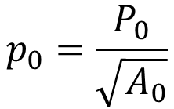
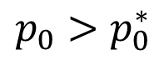
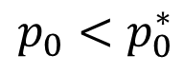
Background
Solid-like
Fluid-like
From Park et al. (2015). Unjamming and cell shape in the asthmatic airway epithelium. Nature materials, 14(10), 1040-1048.
Target shape index:
Critical shape index:
$$p_{0}=\frac{P_{0}}{\sqrt{A_{0}}}$$
$$p_{0}^{∗}≈3.81$$
$$p_{0}<p_{0}^{∗}$$
$$p_{0}>p_{0}^{∗}$$

Slide 4
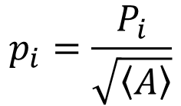
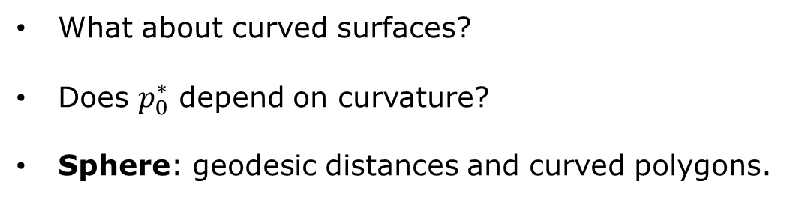
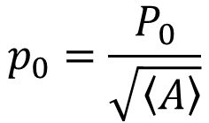
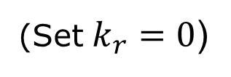
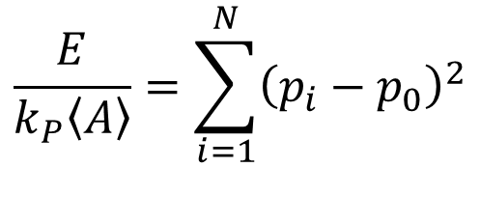
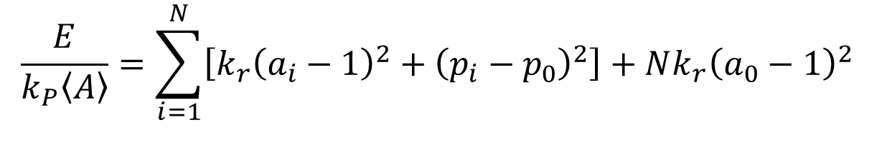
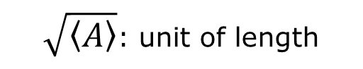
Vertex models on the sphere
What about curved surfaces?
Does $p_{0}^{∗}$ depend on curvature?
Sphere: geodesic distances and curved polygons.
$$p_{i}=\frac{P_{i}}{\sqrt{\left\langle A\right\rangle }}$$
$$\frac{E}{k_{P}\left\langle A\right\rangle }=\sum_{i=1}^{N}{\left[k_{r}{\left(a_{i}−1\right)}^{2}+{\left(p_{i}−p_{0}\right)}^{2}\right]}+Nk_{r}{\left(a_{0}−1\right)}^{2}$$
$$p_{0}=\frac{P_{0}}{\sqrt{\left\langle A\right\rangle }}$$
$$\frac{E}{k_{P}\left\langle A\right\rangle }=\sum_{i=1}^{N}{{\left(p_{i}−p_{0}\right)}^{2}}$$
(Set $k_{r}=0$)
$\sqrt{\left\langle A\right\rangle }$: unit of length

Slide 5
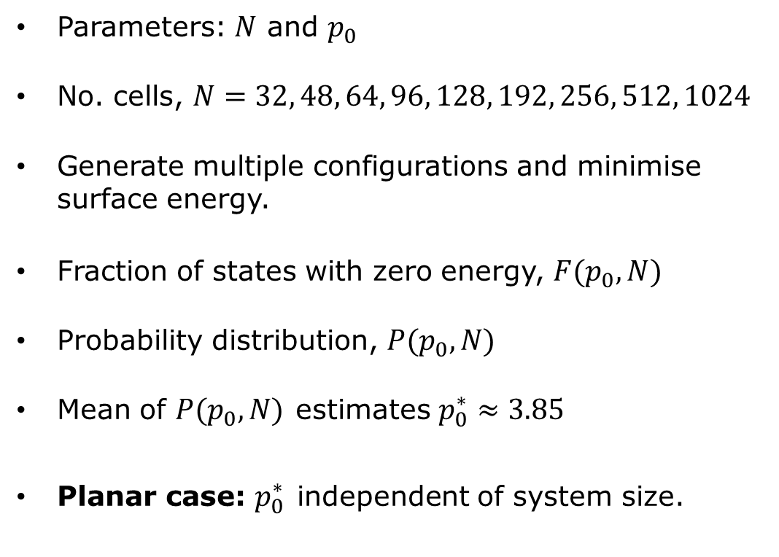
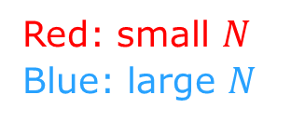
Measuring critical shape index
Parameters: $N$ and $p_{0}$
No. cells, $N=32, 48, 64, 96, 128, 192, 256, 512, 1024$
Generate multiple configurations and minimise surface energy.
Fraction of states with zero energy, $F(p_{0},N)$
Probability distribution, $P(p_{0}, N)$
Mean of $P(p_{0}, N)$ estimates $p_{0}^{∗}≈3.85$
Planar case: $p_{0}^{∗}$ independent of system size.
Red: small $N$
Blue: large $N$

Slide 6
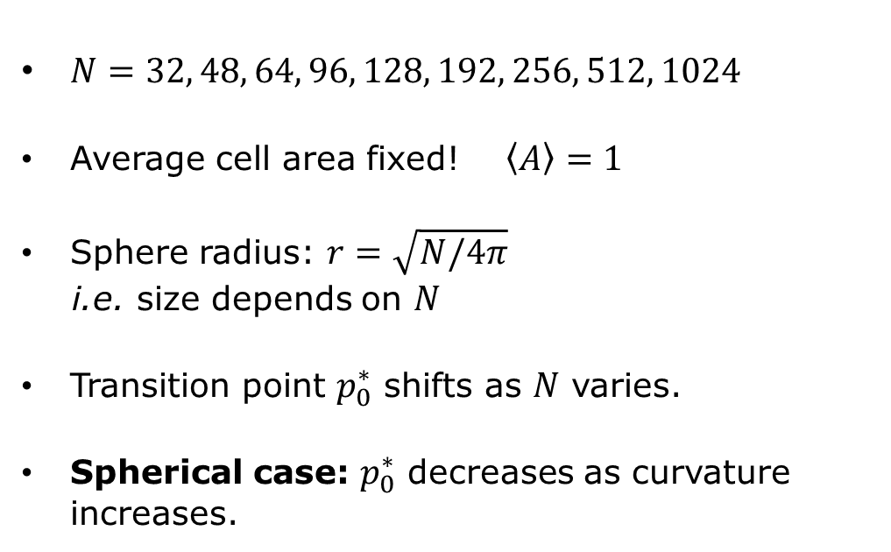

Critical shape index varies with curvature
Red: small $N$
Blue: large $N$
$N=32, 48, 64, 96, 128, 192, 256, 512, 1024$
Average cell area fixed! $\left\langle A\right\rangle =1$
Sphere radius: $r=\sqrt{N/4π}$
i.e. size depends on $N$
Transition point $p_{0}^{∗}$ shifts as $N$ varies.
Spherical case: $p_{0}^{∗}$ decreases as curvature increases.

Slide 7
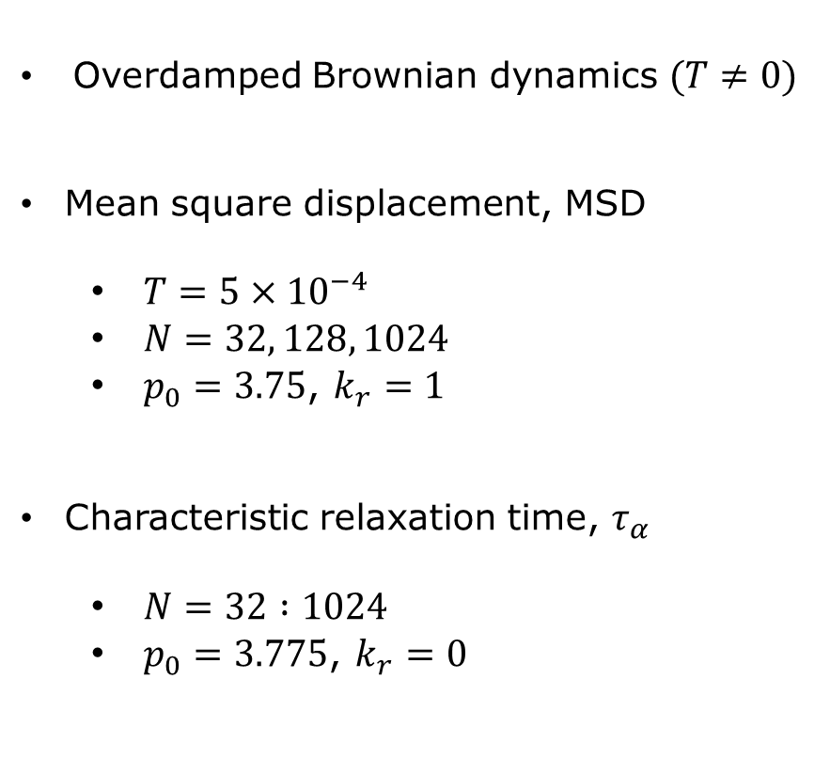
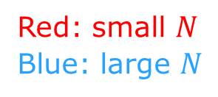
System size influences cell behaviour
Red: small $N$
Blue: large $N$
Diffusive
Caged
Overdamped Brownian dynamics $(T≠0)$
Mean square displacement, MSD
$T=5×{10}^{−4}$
$N=32, 128, 1024$
$p_{0}=3.75$, $k_{r}=1$
Characteristic relaxation time, $τ_{α}$
$N=32 :1024$
$p_{0}=3.775$, $k_{r}=0$

Slide 8
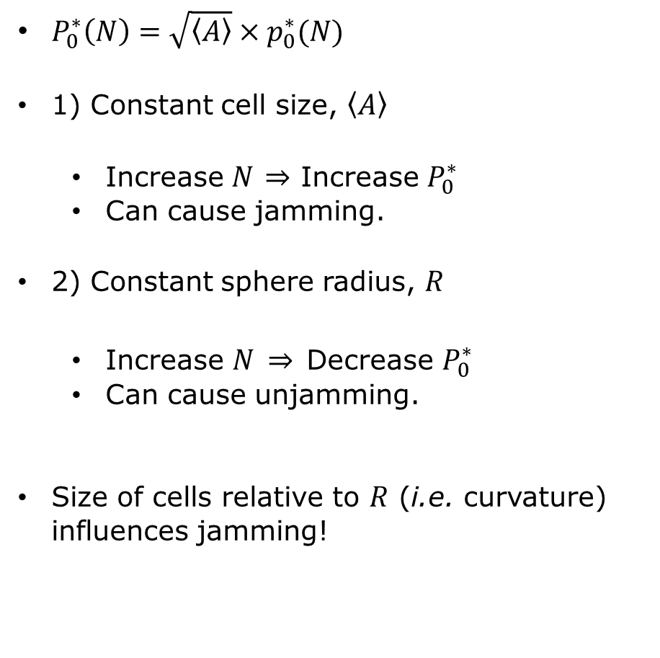
Growth can cause jamming or unjamming
$P_{0}^{∗}\left(N\right)=\sqrt{\left\langle A\right\rangle }×p_{0}^{∗}(N)$
1) Constant cell size, $\left\langle A\right\rangle$
Increase $N$ $⇒$ Increase $P_{0}^{∗}$
Can cause jamming.
2) Constant sphere radius, $R$
Increase $N$ $⇒$ Decrease $P_{0}^{∗}$
Can cause unjamming.
Size of cells relative to $R$ (i.e. curvature) influences jamming!

Slide 9
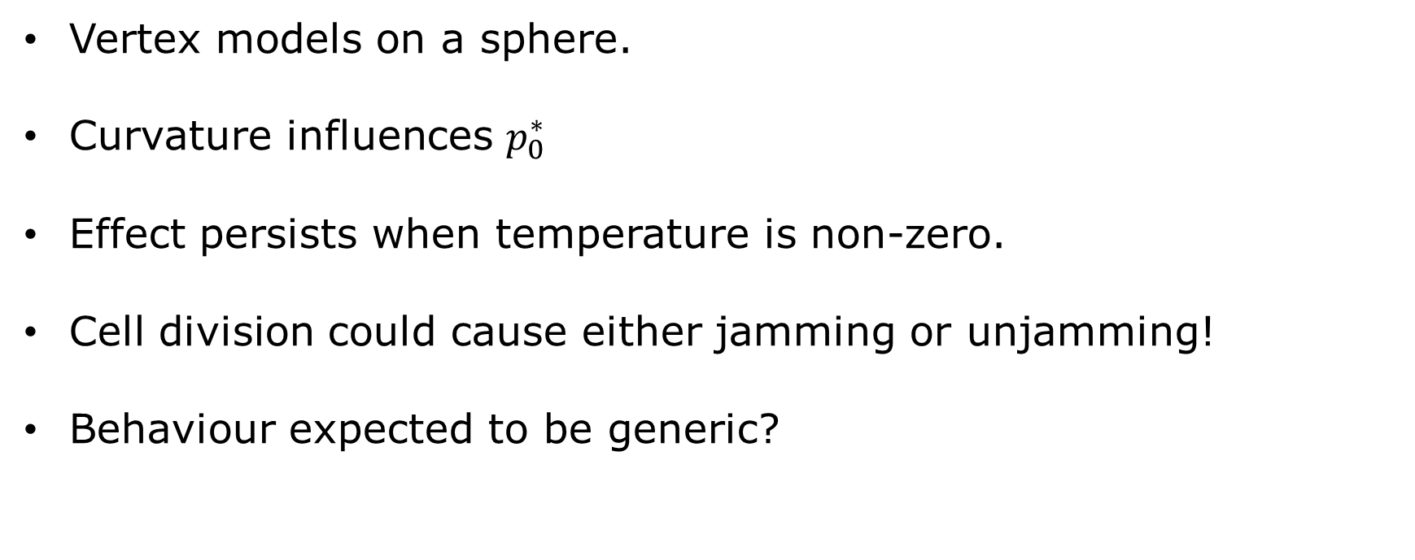
Summary
Vertex models on a sphere.
Curvature influences $p_{0}^{∗}$
Effect persists when temperature is non-zero.
Cell division could cause either jamming or unjamming!
Behaviour expected to be generic?

Slide 10

Warning: highly idealised model

